Slide 1
Getting Started
Writing Clean, Maintainable C++ Code

Slide 2
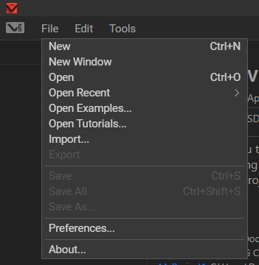
Creating A Project

Slide 3
Creating A Project
Use the Competition Template!

Slide 4
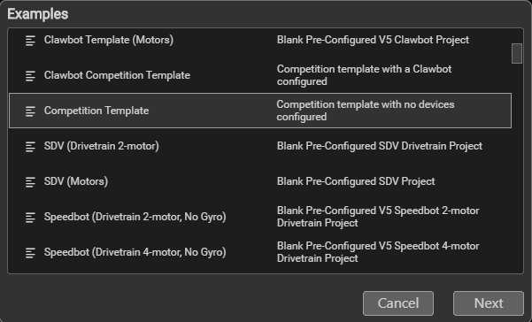
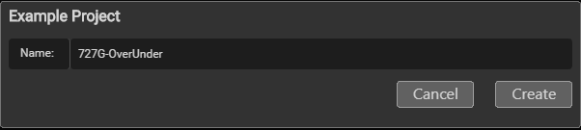
Create Your Project
Use a recognizable name!
Avoid things like “1”, “727G-code”, or “test-project”

Slide 5
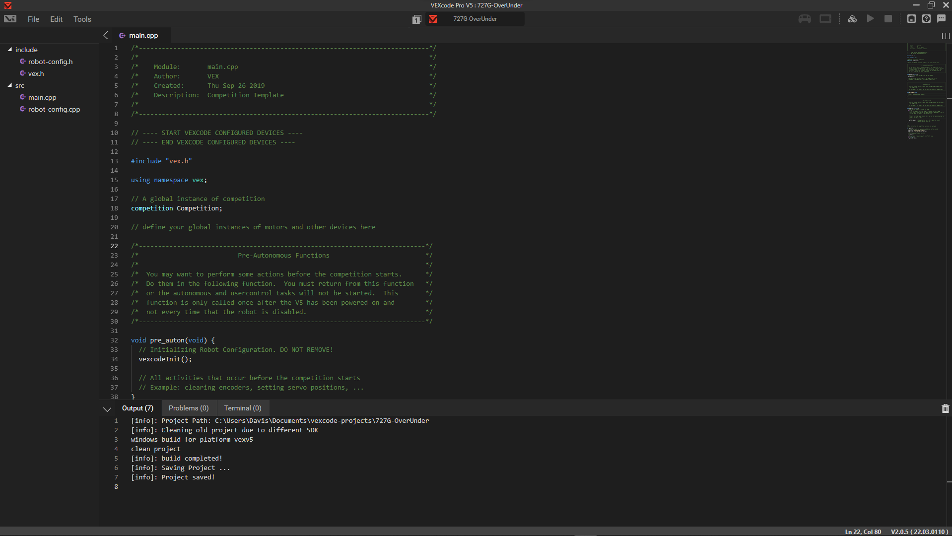



Program Slot
Connection Status
Build and Upload
Add Devices (Motors, Inertial Sensors, etc.)
Project Files
Any problems will show up here!

Slide 6
Working With Functions

Slide 7
Why Use Functions?
Functions help us split our code into “chunks” so we can reuse certain parts. Just like the name suggests, functions perform a specific task, or function, and they can have inputs and outputs. They’re essentially mandatory for writing clean, readable code in VEX.

Slide 8
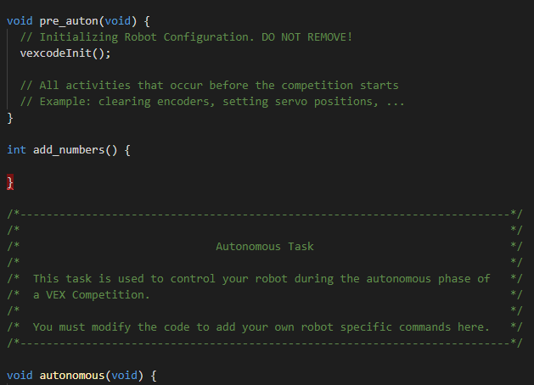
Let’s Create a Simple Function
The goal of our function: add two numbers together
The red means “error” and is basically
VEXCode telling us there’s a problem
with our code that we must fix.
If we hover over the red, it will tell us what the problem is. In this case, the error is simply telling us our function doesn’t return a number like we said it would.
The “return type” of our function
The name of our function

Slide 9



Completing Our Function
Function Parameters – the inputs to our function
In this case, we want our function to take in two “ints” (numbers), one called “a” and one called “b”.
Return Statement – the output of our function Since our goal is to add “a” and “b”, we can simply type “a + b” and return that. NOTE: Any code after this return statement will not be run.
Our error is gone! This is because we’re now “returning” a number like we said we would.

Slide 10
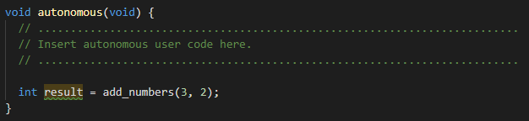
Using Our Function
Functions don’t do anything until they’re “called”, or until we use them.
This code will call our function with the numbers “3” and “2” and save the result of our function to a variable called “result”. A variable is simply a “container” that holds data (numbers, text, etc.)
The green squiggle is a “suggestion” telling us that we aren’t using the variable “result” anywhere and we can safely delete it.

Slide 11
What Happens When Code Doesn’t Work?
When we get the red “squiggles” we saw a bit ago, or when our code simply isn’t behaving like we would expect, we have a bug. Naturally, we want to remove that bug, which we do through a process called “debugging”.
Error messages you get may seem confusing, so it never hurts to ask someone or Google something if you’re stuck. If you don’t have an error message but your code isn’t working like you expected, it never hurts to start removing lines of code until the issue disappears (or ask for help)! Try to break down problems into small steps to make them easier to solve.

Slide 12
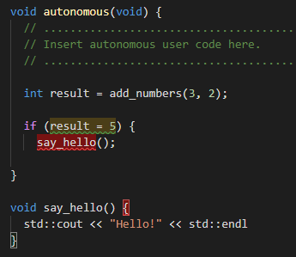
Finding Bugs: Practice
Common mistakes: - Forgetting a semicolon (“;”) at the end of a line. - Missing curly brackets (“{“ and “}”) - Placing function declarations after you call them
- Using “=“ instead of “==“ (“=“ sets a value, “==“ compares two values)

Slide 13
Moving Your Robot
Adding motors to your code and using them!

Slide 14
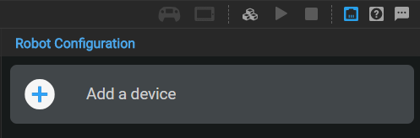
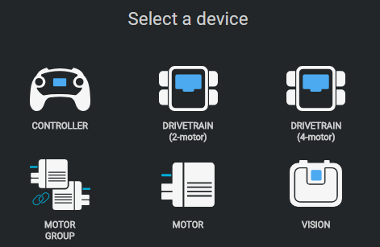



Adding a Motor

Slide 15
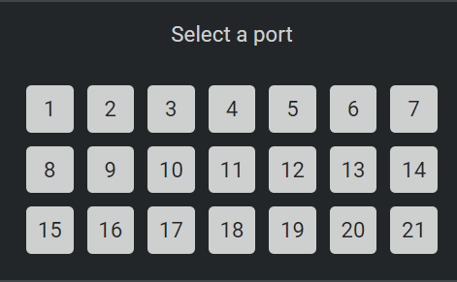
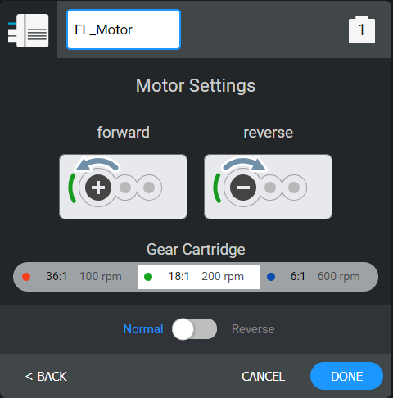


Adding a Motor
Give your motor a descriptive name (FL stands for front left here)
Select your cartridge gear ratio
Flip switch for reverse

Slide 16
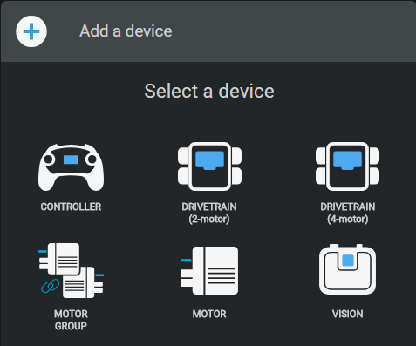

Our wheels are linked together, so why do we need to manually add each motor?
We don’t! If you have motors that are linked together via gears, they’re known as “mechanically linked” motors, and we can use something called a “motor group”. (You can also use them if your wheels aren’t mechanically linked).

Slide 17
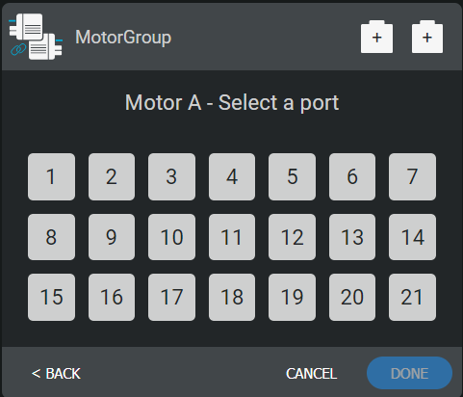
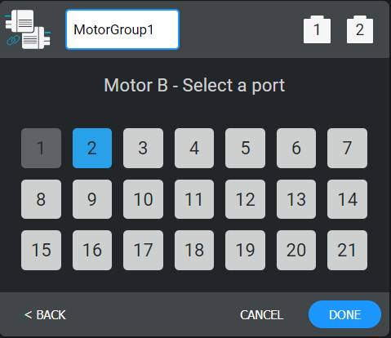
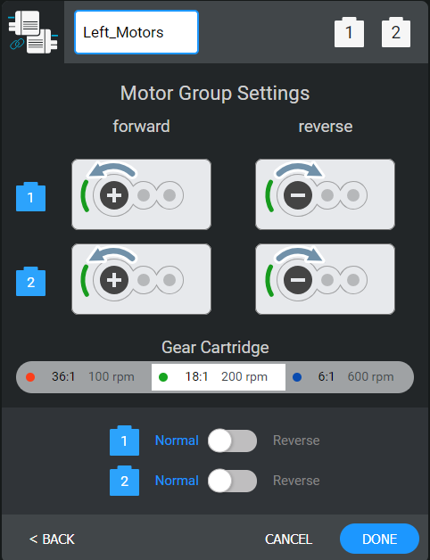

Use a descriptive name! Simply typing something like “motors” will likely confuse you later while you’re coding (especially if you have multiple motor groups).
This setting is way more important now! We don’t want our motors working against each other, since they can be damaged. If you suspect this is happening, stop your code.

Slide 18
Add Your Motors Now

Slide 19
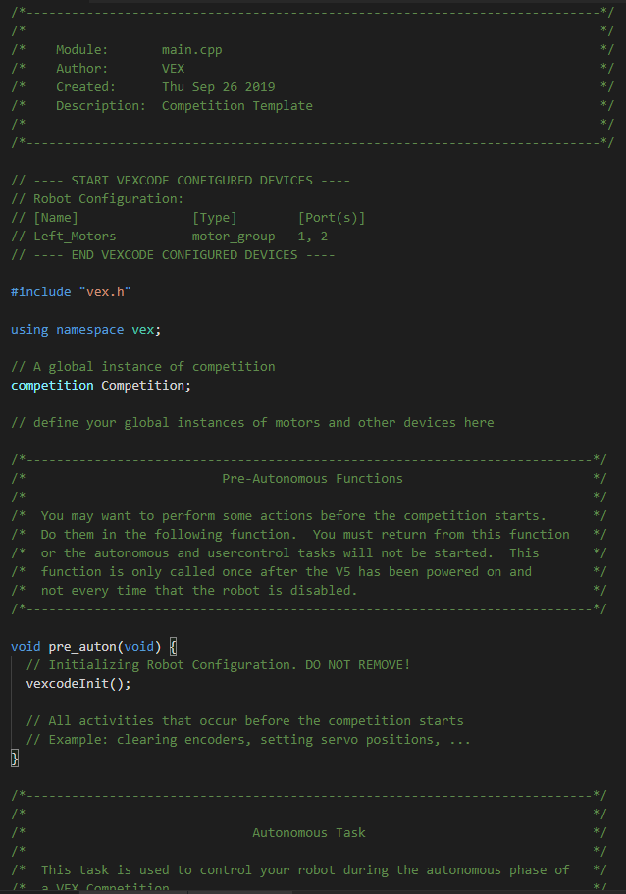




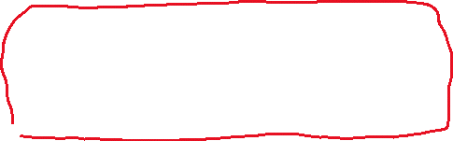
Let’s Clean Up The Code
Everything in green is a comment, or a note in your code. The competition template comes with a lot of comments that can safely be deleted.
These sections contain useful information about your code! You can delete them if you really want to, but I recommend keeping them. Feel free to edit the section at the top by entering your name, the date, and a description of your code if you’d like (you can change this at any time).
You may want to read through some of these comments, so if you’d like to keep them you absolutely can.

Slide 20

The Code: An Overview
Your team can choose to take advantage of a period called the “autonomous period”. During the autonomous period, you can score points and move your robot around autonomously (without driver input) before driver control officially starts. All your code for this part of the match should be called from here, and this function will forcefully end after the autonomous period is over.

Slide 21
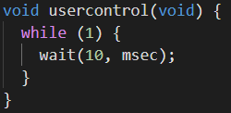
The Code: An Overview
After the autonomous period ends, driver control starts. All your code which lets the driver move the robot should go here.
The “while (1)” simply tells your robot to repeat the code in this section forever (until the match ends).
The “wait” function is very important here, because it gives the VEX brain some time to process inputs. By default, this value is probably 20 milliseconds (0.02 seconds), but from my testing the brain can handle 10 milliseconds fine. The lower this number is, the more “responsive” our code will be, but we can only push it so far before the limits of the VEX brain’s hardware become apparent.

Slide 22
Writing Drive Code
Time to use the motors! By the end of this, you should be able to drive your robot around.

Slide 23
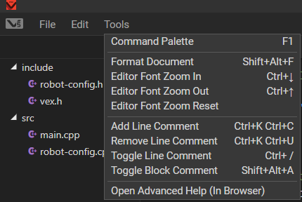

Let’s Break Down The Problem
What we want to do: move the robot (forward, reverse, turn) by moving the joysticks on our controller
Steps:
Figure out how to get the value of our joysticks
Send that value to the correct motors
“Where do I start?” and “How do I know what to type” are both valid questions at this point. In order to figure out what functions are available to us, we need to use something called an API Reference.

Slide 24
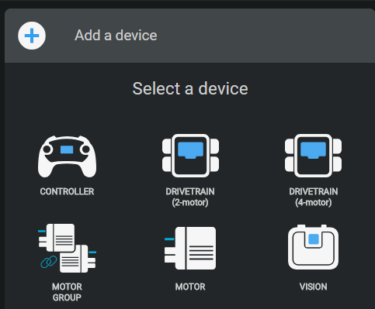
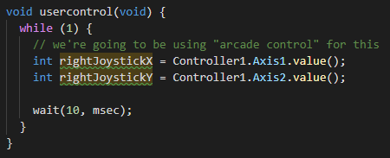

Getting Joystick Input
Add a controller to your code!
Save the joystick inputs to variables
Note: you can use any two axes you want! For example, the left joystick would be 3 and 4.

Slide 25
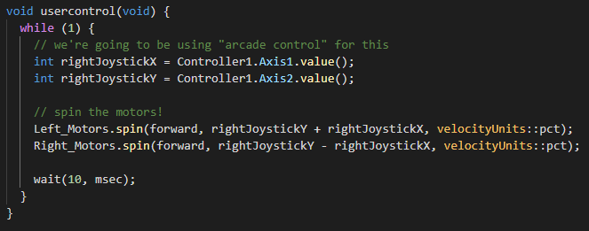
Sending Our Input To Motors
We can now spin the motors! I used “rightJoystickY + rightJoystickX” in order to allow our robot to move and turn. We can now upload this code by plugging in a controller and hitting the “upload” button in the top right!

Slide 26
Test It!
Go to the “programs” section on your controller
Press “A” to select your program
Click the “run” button and try moving the joystick!
If all went well, your robot should be moving around!
Common problems: - Program not there? Make sure you’ve successfully uploaded it
- Robot not moving? Make sure your motor groups are set up with the correct ports and have the correct reverse directions

Slide 27
Challenge
Make a function called “MoveRobot” that takes in the inputs from your joysticks and moves the motors.
move_motors(x, y);
Hint: functions can have a return type called “void” that makes them return nothing

Slide 28
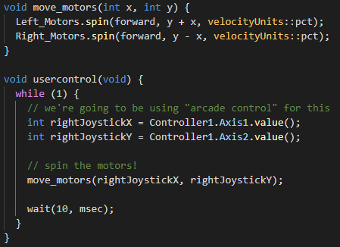
My Solution
Yours might look a bit different, but the key is working code!

